Slide 1
Money Matters
Addressing the Cost of Living Crisis

Slide 2

Welcome
Notes:
Welcome back

Slide 3
Meet your Facilitator
Meet your Facilitator
Name
Title
Name
Title
Remember: I am NOT a Financial Advisor
Notes:
Add your photo and remind the attendees that you are not a financial advisor

Slide 4
Course Proceedings
Ask Questions
Join in with the Interactive sections
Learn from One Another
Notes:
Quick reminder of how to get the best out of the course

Slide 5
Course Expectations
This Course is Informal – Have Fun!
Don’t Assume Knowledge
  Just because something seems obvious to you does not mean it will be obvious to everyone!
Allow Everyone to Make Their Own Decisions
Do Put Into Practice What You Learn

Slide 6
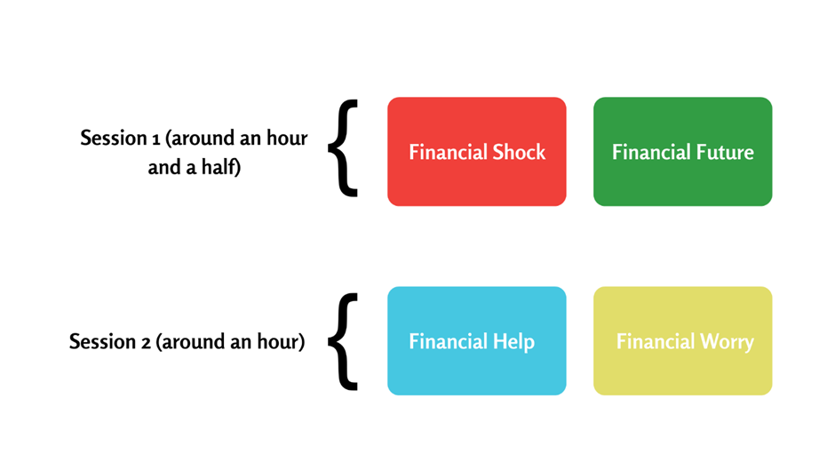
Course Structure
Financial Worry:
An Introduction
Financial Shock: Looking At Income
Session 1
Financial Help:
Regular Bills
Financial Future:
Adjusting Your Budget
Session 2
Financial Deficit:
Loans & Debt
Notes:
Go over last session quickly and set this session in context
Any one do the spending diary?
Any relevant and immediate points?

Slide 7
Financial Help
Monthly Bills
Notes:
We are going to look at ways to help reduce or handle regular monthly bills

Slide 8
Mortgage Payment Holidays
All Banks Able to Offer - Check with Your Bank
Unpaid Interest Will Still Need Repaying
  Tracker/Variable Rate Payments May Reduce
Individual Credit Ratings Shouldn’t Be Affected
  Check with Your Lender
Avoid Taking Out Credit Unless You’re Certain You Can Repay It
Notes:
This is a temporary break from your mortgage payments.
you will need to not already be in arrears on your mortgage.
you will either pay a little bit more each month,
or your mortgage term will be extended slightly.
it is better to apply online if you can due to busy phone lines
Always talk to your mortgage provider if you are having difficulty

Slide 9
Rent
Speak to Landlord & Tell Them Your Situation
Draft Letter for Contacting Your Landlord: JFF Help Hub
Eviction Proceedings Can be Paused
Check Universal Credit & Housing Benefit Eligibility
  Apply for Universal Credit
  Apply for Council Tax Reduction
Notes:
Speaking to your landlord – tricky conversation? Use the letter on the Just Finance Foundation help hub

Slide 10
Household Bills: Gas & Electric
Gas/Electricity Suppliers Have Emergency Packages
It is currently NOT possible to get a cheaper option by switching Energy Provider
Guidance on Prepayment Meters
  Can’t Afford to Top Up Prepayment Meter?
  Can’t Get to a Shop to Top Up Prepayment Meter?
Notes:
The next few slides cover some suggestions for saving on expenditure. This is a good opportunity for others to share their ideas too. Be sensitive that for many people these suggestions are part of their normal life of struggling to balance their finances.
Remember that the cap is on the unit rate NOT the total amount payable each year
Suppliers may offer:
Credit in post or funds automatically added
Sending someone to top up meter
Individual situations will be assessed – agreements made.
Grants scheme to help suppliers support vulnerable
Check with provider – check you are on the best tariff
dig out a recent copy of your bill for details of the number to call to talk to your provider

Slide 11
Household Bills: Gas & Electric
You will need to reduce consumption to lower your monthly bill
Check that your monthly Direct Debit payment is reasonable against your forecast annual usage
Don’t just stop paying, contact your energy provider if in difficulty
Notes:
Suppliers may offer:
Credit in post or funds automatically added
Sending someone to top up meter
Individual situations will be assessed – agreements made.
Grants scheme to help suppliers support vulnerable
Check with provider – check you are on the best tariff
dig out a recent copy of your bill for details of the number to call to talk to your provider

Slide 12
Household Bills: Gas & Electric
Is your home properly insulated ?
Have you got low energy light bulbs ?
  80% less energy for the same light
Do you have a slow cooker ?
Can you turn down the thermostat ?
One degree can save 10% on energy cost
Notes:
Suppliers may offer:
Credit in post or funds automatically added
Sending someone to top up meter
Individual situations will be assessed – agreements made.
Grants scheme to help suppliers support vunerable
Check with provider – check you are on the best tariff
dig out a recent copy of your bill for details of the number to call to talk to your provider
Citizens advice – switching

Slide 13
Household Bills: Water and Council Tax
Council Tax
  Speak with your Local Authority as they can have discretionary funds to assist
If You Can’t Pay Your Water Bill
  Speak to You Water Company ASAP
  Resource: if you’re struggling to pay your water bill.
Notes:
Check local council – they have been given money to support vulnerable households
Defer payments
Water – cannot by law be disconnected – speak to provider

Slide 14
Household Bills: Food
Downshifting
  Try the cheaper brand alternatives
Make your own dishes
  Home made chicken nuggets for example
  Pasta sauces
Notes:
Cheaper brands – try them out to see the difference
Try the cheaper supermarkets – Adli, Lidl, etc
Use Tesco Clubcard if in Tesco
Use loyalty cards for offers and discounts

Slide 15
Household Bills: Fuel
Increase miles per gallon by –
Slowing down !
Keeping your vehicle maintained and serviced
Gentle right foot, stay in highest gear possible
Anticipate traffic to avoid braking and accelerating
Don’t leave roof bars and boxes on when not in use
Only use air con when really need to
Lighten the load, don’t keep heavy items in the boot
Source: RAC

Slide 16
Existing Loan, Overdraft, or Credit Card Payments
Consider the options re interest rates
Can debts be consolidated ?
Take advice from a Debt or Money Advice charity
Notes:
some lenders are offering payment holidays.
Contact your lender if you think you will struggle to make repayments on a loan or credit card debt.
do not stop making payments or cancel your direct debits until you have spoken to your lender to find out how they can help.

Slide 17
Questions?

Slide 18
Financial Future
Adjusting Your Budget
Notes:
Adjusting or making a budget if you don’t already have one

Slide 19
How Do I Budget For This Period?
Accept That This is a Very Challenging Time
Entitlements Are Changing Rapidly
Manage your money in uncertain times: Money Helper
  Feeling Lost/Don’t Know Where to Start with Budgeting?
  Find an Online Budgeting Resource
Notes:
Past ways to save money may no longer be possible but it is still important to make a plan.
Keep up to date on entitlements
Budget in a way you feel comfortable with – paper, apps, webpages, etc….

Slide 20
Budgeting, Tools, & Apps
You Could Plan for Three Scenarios:
  Normal Budget
  Best Case Scenario
  Worst Case Scenario
Budgeting Tools
  Online: Money Helper Budget Planner
  Downloadable/printable: StepChange Budget PDF
  Excel Spreadsheet: Money Saving Expert budget planner
Notes:
The Money Advice Services online budgeting tool is the most detailed and has useful graphs and images if you’re a visual learner.
Printable versions available

Slide 21
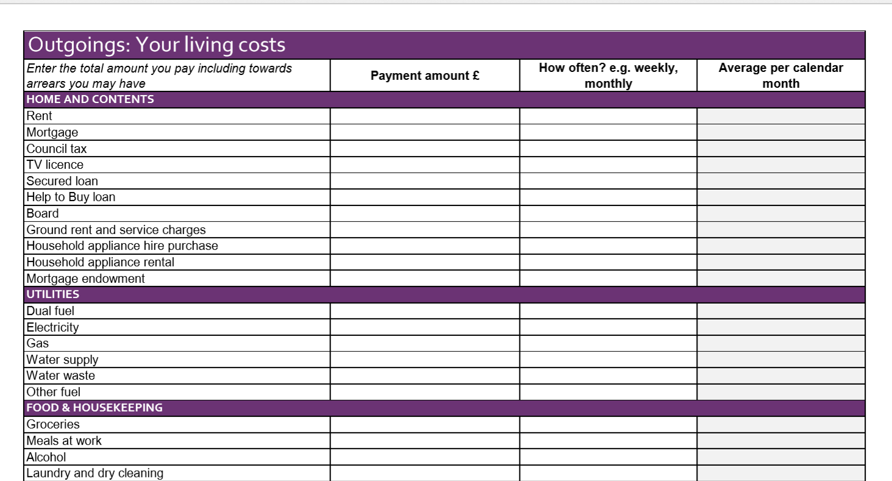
Budgeting Tools Example:Step Change Printable
Notes:
Printable example

Slide 22

Easy and Effective Budgeting Approach
3 accounts
1) Regular Bills
Rent/Mortgage
Water and Energy
Council Tax
2) Everyday Spending
Food
Travel
Leisure
3) Savings
Any money remaining
Notes:
Can do this physically, using different accounts or just on paper.
Ensures regular bills get paid no matter what time of the month they are paid out.
Tip – try to get three months worth of savings – to cover all payments for that time.

Slide 23
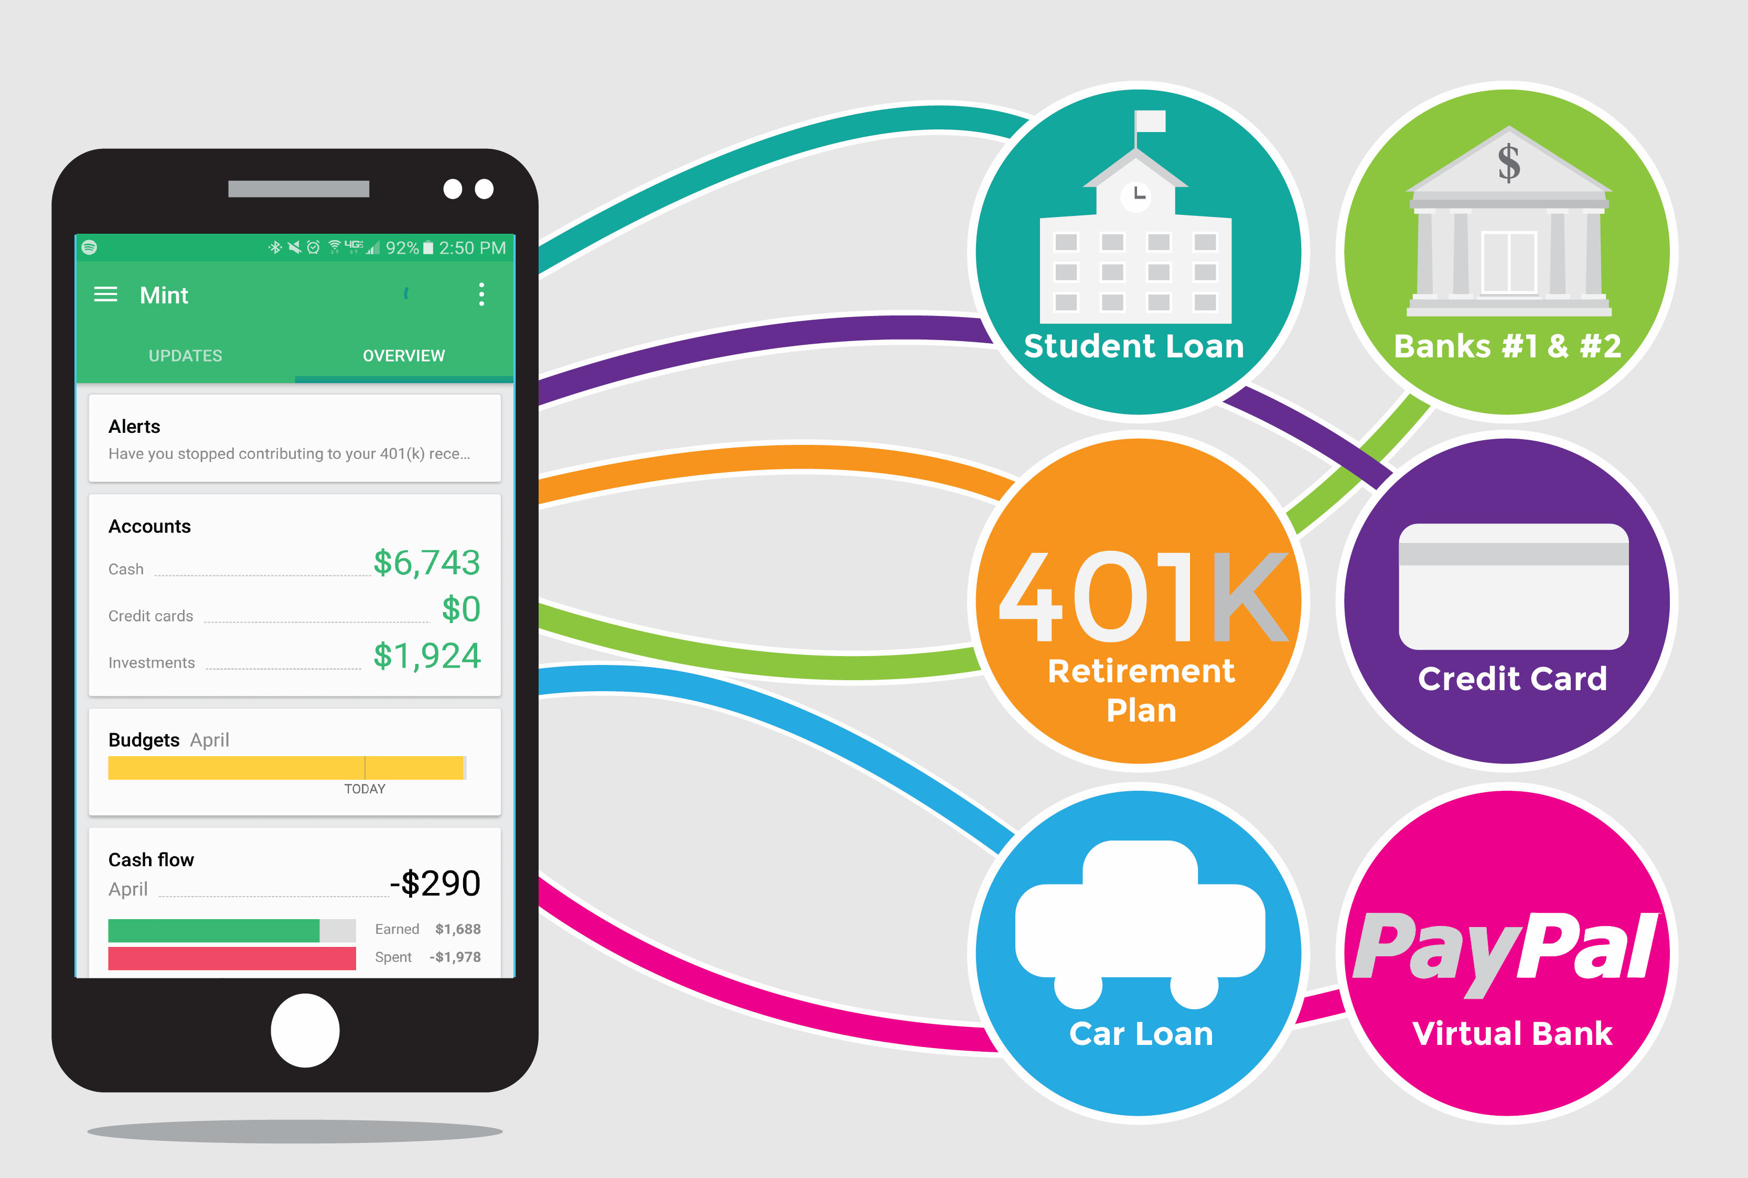
Budgeting Apps Examples
IOS & Android Budgeting Apps:
Mint: Best Overall
PocketGuard: Best to Help Overspending
Wally: Best for just Budgeting
Mvelopes: Best for Cash Style Budgeting
Goodbudget: Best for Couples
Simple: Best App Tied to a Bank Account
Notes:
Share budgeting tips amongst the group

Slide 24
ACTIVITY:
All You Need Is Your Bank Statement and a Pen
Some key things to look out for:
1) Where Can You Cut Back?
Travelcards
Free trial deals that expired!
TV services (Netflix)
Apps
Games
Club or Group Memberships
Gym/Leisure Centres
Magazines/Newspapers
Music streaming services
Any paid for apps
Regular charity donations
2) What Can You Cut Off?
3) What Have You Forgotten About?
4) What Do You Love and Need to Keep?
Notes:
Do this with participants – not necessarily on the facilitator course
Look at 6 months – 12 if poss
Things you can cut back
Things you can do without
What have you forgotten
What do you love

Slide 25
Saving Money on Food
Always Use Fresh Ingredients First
Know What Food Keeps Longest
Check What Food You Have Before Buying More
Create a Weekly Menu
Keep Soup & Micro/Frozen Meals for Emergencies
Vulnerable -
Community larders and Foodbanks
Notes:
Consider smaller independent or world food shops – caution – these may be more expensive than the larger food shops/supermarkets
Have some things in your cupboard in case you need them
Add local knowledge here

Slide 26


Cheaper Cooking
BBC Good Food Recipes and Guides
Family Dinners at Less than £1 per Head
Jack Monroe is Dedicated to Cheaper Cooking
Cooking on a Budget Tips?
Foodbanks : Find Your Local Foodbank
  Speak to Citizen’s Advice for a Referral
Notes:
Foodbanks – discuss, check local knowledge and make sure you have a note of your local one

Slide 27

Free School Meal (FSM) Entitlements
Children Previously Eligible for FSM Still Supported
Schools Track Eligible Pupils/Those Still Receiving
Some Schools Supplying Meals Via Food Provider
Centrally-Funded National Voucher Scheme
  Check with Your Child’s School
Vouchers Made Available to Child Guardian
Notes:
Your child may be able to get free school meals if you get any of the following:
Income Support
income-based Jobseeker’s Allowance
Child Tax Credit (provided you’re not also entitled to Working Tax Credit or on Universal Credit)
Working Tax Credit run-on - paid for 4 weeks after you stop qualifying for Working Tax Credit
Universal Credit
Check with your local school – if you are on their list and also how they are delivering

Slide 28
Questions?

Slide 29
Debt and Loans

Slide 30

I’m in Debt – What Do I Do Now?
It’s Okay to Find Yourself in Debt, You Will Feel Better When You Address It
Don’t Ignore It
Get Free & Impartial Debt Advice Before You Take Action
Notes:
You have taken the first step – you have started to talk about your debt and from that can come the first steps in addressing the problem
Debt does not go away by ignoring it – no matter how much we wished it would
If the debt level is serious, refer the person direct to a debt advice charity
Do not be tempted to offer financial advice

Slide 31
Get Expert Debt Advice
Struggling with Debt Repayments?
Contact a debt advice service. A full list can be found here.
Online Services Include:
www.payplan.com
www.citizensadvice.org.uk
www.Tully.co.uk
https://www.crosslightadvice.org/
Telephone Services Include
National Debtline: 0808 808 4000
  StepChange: 0800 138 1111
  Christians Against Poverty 0800 328 0006
Notes:
Seek advice from a specialist debt advice service.
A list of providers can be found on the Money Advice Service website at https://www.moneyadviceservice.org.uk/en/tools/debt-advice-locator
Tully can help by accessing your bank statements, if you give them permission,
You can also get help over the phone.
If you think you will need extra help, you could ask someone you trust to call them with you (always try and seek professional support to safeguard yourself against financial abuse as the person of trust will have access to sensitive data),
using a 3 way phone conversation. Some links to help you do that are at the bottom.
have your bank statements and bills handy
tell them about your income and expenditure and any money that you owe.
They will help you build a budget, work out what you can afford to repay, and can speak to people you owe money to, explaining the situation and how much you can afford to pay.
be honest and tell them the full situation. You don’t need to be embarrassed, they have helped thousands of people in similar situations and will be sympathetic and non-judgemental.
https://www.dummies.com/consumer-electronics/smartphones/droid/how-to-make-a-conference-call-on-an-android-phone/
https://www.bt.com/help/landline/all-about-3-way-calling (there is a charge for this option)
https://www.dummies.com/consumer-electronics/smartphones/iphone/how-to-make-a-conference-call-on-your-iphone/

Slide 32
Before Taking A Loan, Consider
If, After Maximising Income and Adjusting Spending, You Still Need to Borrow Money, Consider This:
Can you safely borrow from friends or family?
Will an overdraft be enough?
Can you get a loan from the bank?
Can you get a 0% interest credit card?
Notes:
Options to consider:
Can you borrow from friends or family? Ensure they are ok and can afford this - work out a budget first to make sure you can definitely afford to repay the loan – put it in writing so everyone agrees
Small amount £500 or less? – use your overdraft? Check your bank for all details
Good credit rating? – bank loan?
0% interest credit cards? – check small print – have a plan!

Slide 33
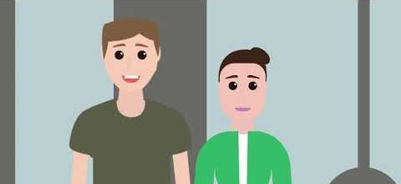




I Think I Need a Loan: Credit Unions
Notes:
Most responsible credit providers also provide help and advice and commit to only making fair and affordable loans.
search their directory here and find providers that might consider lending you money https://www.findingfinance.org.uk/
Credit unions are non-profit organisations and they are often able to lend money at lower rates (less than 43% APR) than traditional lenders such as banks and payday lenders. Credit Unions are an alternative especially for those tempted to use illegal lenders
Do not recommend Cu’s as this would be seen as favouring CU and advising people to use them over other lenders. You probably have one local to you, but most transactions can be completed online or over the phone. You can find your local credit union here https://www.findyourcreditunion.co.uk/

Slide 34
I Think I Need a Loan: Benefits
Budgeting Advance for £100-£800 Based on Circumstances
Budgeting Loan for £100-£800 Based on Circumstances
Receiving Universal Credit
Receiving Pension Credit, Income Support, ESA, or JSA?
For at Least 26 Weeks?
Notes:
Interest Free Loans for those Already on Benefits
UC – Budgeting Advance
Legacy – Budgeting Loan
cheaper than paying high interest charges for borrowing from payday or doorstep lenders.
for an essential or unexpected expense
You can apply for a Budgeting Loan if you’re getting one of these benefits:
Pension Credit
Income Support
Income-based Jobseeker’s Allowance
Income-related Employment and Support Allowance.
You must have been claiming for at least 26 weeks, either consecutively or with a break of no more than 28 days.
normally have to pay it back within two years. Repayments are usually automatically taken out of your benefits.
If you stop getting benefits while you’re paying back the loan, you’ll need to agree another way to pay the money back.

Slide 35
Things to Consider When Choosing a Loan
Shop Around & Compare Deals
The Interest Rate & Annual Percentage Rate (APR)
How Much You Will Repay In Total
Whether You Can Afford the Monthly Repayments
Are There Penalties for Missed or Late Payments?
The Cost per Week or Month & Whether This Varies
Notes:
It is important that you choose the right type of credit or loan for your situation.
Shop around and compare deals, looking at the interest rate and the Annual Percentage Rate (APR) how much you will repay in total, whether you can afford the repayments
Check if there are any penalties for missed or late payments and make sure you understand the cost per week or month and whether this might vary.
pay a loan back as soon as you can. If you can afford higher repayments, you reduce the amount of time you borrow the money for and this saves you money in the long run, this does however come with added risks as it increases your monthly expenditure.

Slide 36

Avoid Exploitation
Signs of Illegal Money Lending & Loan Sharks
Little or No Paperwork
Unclear about Interest Rates or Fees
Increase the Debt or Add Charges
Get Nasty & Use Threats or Violence
0300 555 2222
Stop Loan Sharks Project
Call for support, an intervention
or to report a loan shark
Notes:
Vulnerable people are targets for Loan Sharks
A Loan Shark is a lender who might: See Slide
The Financial Conduct Authority (FCA) keeps details of all authorised lenders. You can check on this site or ask someone you trust to check for you https://register.fca.org.uk/
Loan Sharks can only make empty threats – what they are doing is illegal!

Slide 37
Questions?

Slide 38
Financial Worry:
An Introduction
Financial Shock: Looking At Income
Financial Help:
Regular Bills
Financial Future:
Adjusting Your Budget
Financial Deficit:
Loans & Debt
Notes:
Summarise where we hve been on the discussions, where is the best place to focus?

Slide 39
ACTIVITY: Look Again at the Financial Worry Written Down at the Start
What Are Your Next Steps?
What Resources Might Be Useful?
What Might You Be Entitled To?
Whose Support Might You Need?
When Will You Take Action?
Notes:
Making people accountable for their future action – even if by only writing down the next steps.

Slide 40
Further information :
https://www.rochester.anglican.org/community-engagement
Magali.vanderMerwe@rochester.anglican.org

Slide 41

Thank You for attending our Money Matters Course

