Slide 1

FINANCE PRESENTATION
Treasurers' Conference
November 2020
Notes:
Each year the Diocesan Synod approves a budget for diocesan expenditure. This includes the cost of deploying our clergy as well as other costs in support of our mission and ministry in our communities. This presentation summarises and explains the figures for 2019.
During the year regular reports are presented to each meeting of the Finance Committee and Bishop’s Council, that monitor the position of both income and expenditure, and any concerns are highlighted. If necessary, action is taken to either refine the budget or amend current priorities and activities undertaken, so that we continue to maintain strong budgetary control.
This brief report shows the summary detail of the year end position for all lines of income and expenditure that form part of the diocesan budget.

Slide 2
Notes:
To be signed off by Bishop’s Council on 21 July and made available thereafter.
Technically needs to be presented to Synod in session which wil be at its next meeting planned for 21 November 2020.

Slide 3
FINANCIAL OVERVIEW
Net Income on all funds was a surplus of £1.2M (2018: £2.0M) and, after pension scheme revaluation; Net Assets increased by £3.1m (2018: £3.6m) to £75.2m (2018: £72.1m).
The Operating Result on the Common Fund was a deficit of £0.54M (2018: £0.38M); after support towards stipend costs from the Diocesan Pastoral Account of £500K (2018: £500K).
Budget objective for 2019 was a deficit £0.60M (2018: £0.55M).
General Fund expenditure was within the limit of £13.5M, authorised by Synod.
The reserve balance on the Common Fund was £6.8M (2018: £6.0M).

Slide 4
Notes:
The Common Fund had income of £11.0M (87% of which was from Parish Offers) and Costs of £10.6M, ie deficit of c£0.6M of which almost half our clergy stipends.

Slide 5
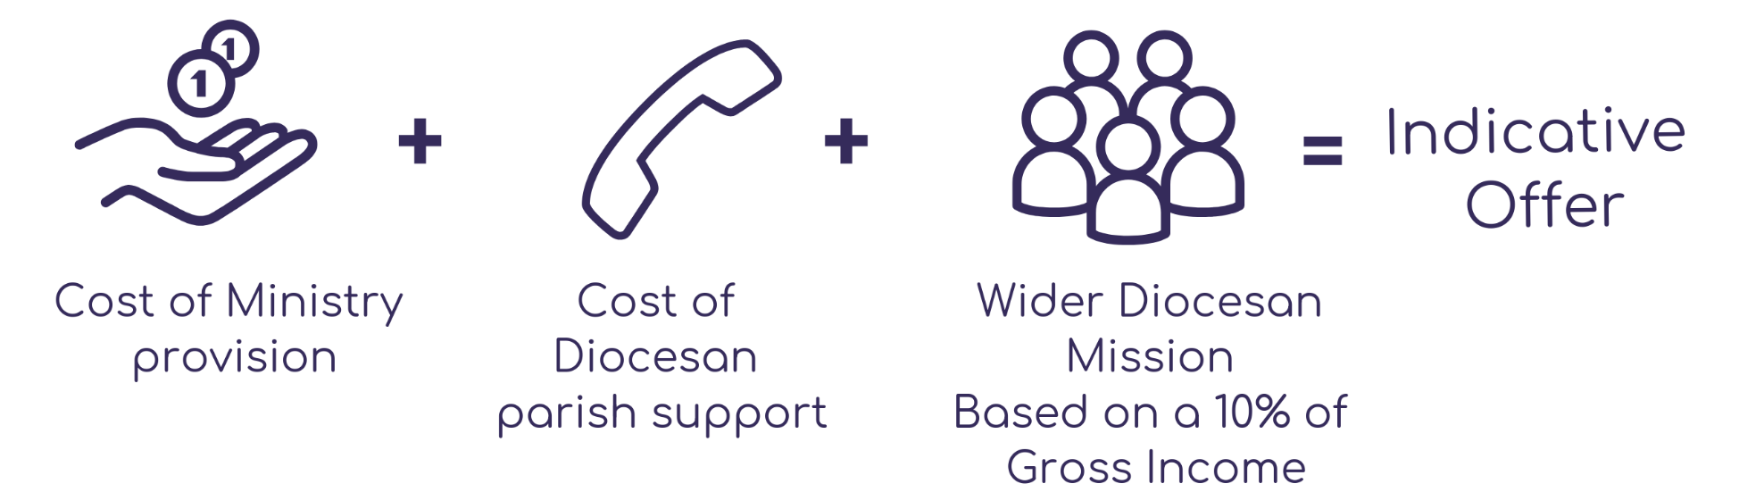


Indicative Offers
Notes:
This system was reached after a long period of consultation and passed by Synod in July 2019
[If available, include a slide of individual calculation]
For those interested there are guidelines of how this is calculated on the diocesan website

Slide 6
SUPPORT COSTS FOR PARISHES – 2020 BUDGET
Cost of a Full-time Incumbent £41K
Diocesan Support Costs £11K
£52K
Average contribution required to cover costs of
Future Ministry, Wider Diocesan Mission and National CofE £14K
Net average contribution required to support parishes unable
to cover fully the cost of a Full-time Incumbent and Diocesan
Parish Support Costs £8K
Average contribution required from Parishes £74k

Slide 7
PARISH OFFER PROCESS
An independent calculation of an Indicative Offer
A formal resolution by the respective PCC(s)
Scrutiny of Parish Offers by an evaluation panel
Preparation of regular and accurate reports to Bishop’s Council
Holding everyone accountable for the delivery of Parish Offers and the fair use of resources
Notes:
Whilst a similar panel has sat in the past under the old Parish Share system, one has not operated in recent years. The approach together with the introduction of Indicative Offers will continue the cultural change within the Diocese with increasing transparency

Slide 8
COVID-19 IMPACT
A time where individuals, parishes, the Diocese and National Church need to work together.
Impact on income from reduced Parish Offers (currently held to c3% reduction re Covid-19), DBF Fees, and dividend and reduced property rentals.
Diocesan staff furlough 35% of staff at peak - saving c£90K, and hold on property expenditure.
Impact on Forecast and 2021 Budget and future projections
Notes:
Many parishes severely challenged financially.
Asking parishes to all they can to maintain Parish Offers, which are largely used to support the clergy stipends.
Parishes are first being encouraged to utilise unrestricted reserves which many have been doing.

Slide 9
COVID-19 EMERGENCY RELIEF FUND
£250,000 in grants and £500,000 in loans made available.
Support most financially vulnerable parishes.
Generous donations from parishes of £21k to date.
Grants of £155k to 31 benefices and £30k reserved for 6 parishes that need funds in the next few months.
Loan facilities available to 5 parishes totalling c£53,700.

Slide 10
NATIONAL CHURCH PARTNERSHIP
Strategic Development Funding
- Chatham Town Centre - £655k
- Missional - £1.44M (matched funding over 5 years)
Covid-19
- Clergy Stipend payment deferral - £1.37M (Loan 12ms)
- Continuity Grant £320K (50% of Covid-19 net impact)
Giving Advisor Fund
  - Generous Giving Officer £120K (50% over 5 years)
Capacity Funding
    - C£120K

Slide 11
BUDGET 2021
Strategic Review - to arrive at a plan of a financially sustainable model of mission for the Diocese
This should entail progressive narrowing of the gap between income and expenditure to steady state but should include targeted investment
Budget is impacted by the severity and longevity of the Covid-19 pandemic
Partnership at all levels - National Church/ Diocese/ parishes/ churchgoers
Short-term measures to control costs (e.g. Furlough of staff and cutting property expenditure and National support) - 2020 forecast deficit contained to £937K
Early in process of transfer to Indicative Offers
Strategic intent and funding just confirmed for full-time Generous Giving Officer

Slide 12
BUDGET 2021
Budgeted deficit of £1,804K (2020F: Deficit £937k; 2020 Base-case Budget of £833K)
The 2021 Budget of £8.0M for Parish Offers does implicitly anticipate recovering levels of parish contributions later in 2021 as Covid-19 restrictions are assumed to lift
A range of scenarios (e.g. best/realistic/worst) have been considered:
  - Worst-case Scenario – 40% fall in parish contributions from pre-Covid levels (£2.8M less than budgeted) - leading to c£1.5M worse than budgeted deficit. There would be sufficient Common Fund reserves and cash

Slide 13
KEY ASSUMPTIONS
Based on £8.0M Parish Offers (plus £0.4M recovery of DBF fees) (2020F: £8.3M; 2020Pre-Covid £8.6M; 2020B: £8.9M)
Average stipendiary clergy posts of 172.5 in 2021, 10.7% vacancy rate (2020B: 181.5, vacancy rate 10.0%)
No stipend or staff salary increase
Property Repairs of £750K (2020F: £750K (inc. £250K catch-up expenditure); 2020B: £750K) and an additional £250K (funded from the Diocesan Pastoral Account) toward additional parsonage repair and maintenance
Common Fund budgeted to reduce to £4.1m by the end of 2021 (Policy of a minimum of £5M)
Net cash outflow of £3.9M projected for 2021 with a projected cash balance at 31 December 2021 of £5.6M

Slide 14
BUDGET 21/ FORECAST 20
Common Fund (£M) | Budget 2021 | Forecast 2020
Total expenditure | 12.62 | 12.52
Estimated capitalisation of property costs | (0.15) | (0.20)
Transfer from DPA to fund property catch-up | - | (0.25)
Funding from other funds | (0.24) | (0.10)
Pension costs provided | (0.57) | (0.59)
Common Fund Net Expenditure | 11.66 | 11.38
Parish Offers | 8.60 | 8.60
Covid impact on Parish Offers | (0.60) | (0.30)
Anticipated Parish Offers | 8.00 | 8.30
DBF Fees | 0.40 | 0.40
Other income | 1.46 | 1.74
Common Fund Income | 9.86 | 10.44
Budget/ Forecast Deficit | £1.80M | £0.94M
Indicative Offers | £9.44M | £9.39M

Slide 15
BUDGETED CASHFLOW ‘21
Negative cash-flow but remaining above liquidity
policy
Cashflow (£K) | 2021B
Operating Loss on Common Fund | (1,804)
Adjustments | (931)
Net Cashflow on Common Fund | (2,735)
Property Disposals | 4,075
Property Additions | (1,980)
Project Capital Expenditure (Kings Hill & Ebbsfleet) | (1,053)
Repayment of clergy stipend deferral loan | (1,860)
Grants and Loans to Parishes | (150)
Contingency | (250)
Net Cash Outflow | (3,953)
Cash b/f (Forecast 1/1/21) | 9,586
Cash c/f (31/12/21) | 5,633

Slide 16
CONCLUDING REMARKS
Budget is impacted by the severity and longevity of the Covid-19 pandemic
Actions in 2020 to manage outturn and national assistance provides confidence in ability to contain deficit
Worst case is fundable, if necessary
Strategic Review to arrive at a plan of a financially sustainable model of mission for the Diocese

Slide 17
QUESTIONS?

