Slide 1
Money Matters
Addressing the Cost of Living Crisis

Slide 2

Welcome

Slide 3
Meet your Facilitator
Name
Title
Remember: I am NOT a Financial Advisor
Notes:
Add your picture, name and title/role
Explain that you are not a Financial Advisor but that you can signpost to one

Slide 4
Course Proceedings
Ask Questions
Join in with the Interactive sections
Learn from One Another
Notes:
Join in with our interactive sections
Learn from each other! some of the most valuable things on this course are added through peoples suggestions – also good for adding in local bits!

Slide 5
Course Expectations
This Course is Informal – Have Fun!
Don’t Assume Knowledge
  Just because something seems obvious to you does not mean it will be obvious to everyone!
Allow Everyone to Make Their Own Decisions
Do Put Into Practice What You Learn
Notes:
Ask silly questions – others are probably thinking the same thing

Slide 6
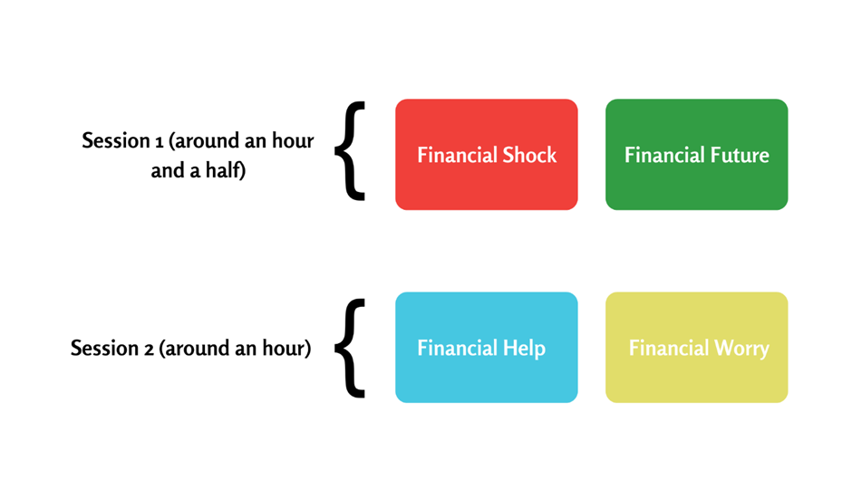
Course Structure
Financial Worry:
An Introduction
Financial Shock: Looking At Income
Session 1
Financial Help:
Regular Bills
Financial Future:
Adjusting Your Budget
Session 2
Financial Deficit:
Loans & Debt
Notes:
Deliver it at your own pace – this is just a suggestion. – we do recommend a break halfway through
We recommend this breakdown because we have structured the course to follow a process of evaluating personal budgets.
Financial Shock looks at maximising income through benefits, tax credits, etc.
Financial Help and Future both address outgoings – Financial Help looking at bills that don’t change, such as utilities or rent, and Financial Future looks at the process of budgeting as well as some areas you can adjust your spends, such as food, fuel and energy.
Financial Deficit If after maximizing your income and limiting your spending, you find yourself still unable to balance your budget, then we would look at credit or loans.
Even if the person you are working with just wants to learn about budgets it is worth running quickly through the other sessions

Slide 7
Financial Worry:
An Introduction
Notes:
We are starting by looking at the impact financial worry can have on your mental health and general well-being
Worry and stress can stop you from addressing the problem in a timely manner

Slide 8
Financial Uncertainty & Mental Health
During this time of uncertainty, it is normal to experience an increase in worry, anxiety, and/or depression.
Money & Mental Health Are Often Linked
Increase in Anxiety/Depression
Advice & Support Available
Notes:
You are not alone
Uncertainty of this situation affects everyone
Money and mental health are often linked – uncertain financial future can lead to stress and worry, mental health issues can lead to money difficulties
Advice and support – help people understand and manage the impact

Slide 9
Stigma Prevents Us Asking About Money Worries
Consider “Safe Openers”:
“How are you doing with your money since fuel prices rocketed?”
“I just wanted to see how you’re feeling; is your
money secure over the next few months?”
Notes:
These can be subtle and useful ways of getting to the heart of mental health and money issues during this time

Slide 10
Talking About Money
Positive Approach:
Encourage: Seek Help Early
Remind: No Shame in This Situation
Listen: to Worries & Concerns
Reassure: They are Not Alone
Things to Avoid:
Ignoring the Problem: help them problem solve
Judgment: you are here to support
Interruption: Listen
Offering Specific Money Advice
  You Must Be Qualified to Do This!
Notes:
Phrases such as ‘everything is going to be alright’ when someone is in debt or serious financial situation can prolong and worsen someone’s financial situation.
Similarly, we shouldn’t judge someone for the issues they may be experiencing. If a participant shares something with us and we criticise them for their issue, they may never open up to anyone again. We all have different priorities for spending our money. It doesn’t mean yours are the right or only way.

Slide 11
Financial Abuse
From Anyone:
Credit in Your Name
Controls Your Accounts
Changes to Will
Taking Money without Returns
From a Partner:
All Bills in Your Name
Dictates How/When You Work
Requires Spending Accounts
Never Shares Their Spending
Help is Available:
Contact Your Bank or Financial Provider
Universal Credit Separate Payments May Be Possible
Follow Your Organisation’s Safeguarding Policy
Notes:
Financial abuse can take a lot of different forms.
Often the abuse is perpetrated by a partner, but it can also come from other relationships, such as family members, friends and carers.
Someone abusive might stop you from having control over your money as a way of trying to exert power over you.
They might also be physically violent, but it’s not always the case.
Examples here of what Financial Abuse might look like: on slide
Social isolation and loneliness might increase the power abusers have and increase the opportunities to control their victims.
As someone working in your community you should always follow your organisation’s Safeguarding policy and procedures and if you have a concern, you should raise it.
It may be hard for Social Services or the police to investigate, but your information could be the missing piece in a jigsaw.

Slide 12




What Support Is Available?
MIND, the UK’s leading mental health charity, have guidance on Coronavirus: MIND - Coronavirus Support
Public Health England have a 5 Question Quiz to provide “Mind Plans” to support you specifically
Created by Martin Lewis, the Money Saving Expert
A network of local groups and services offering mental help support. Visit the website here: Rethink
Notes:
MIND is the UK’s leading mental health charity and they have useful guidance specifically for the Coronavirus.
The Money and Mental Health Policy Institute guidance and resources on their website. created by Martin Lewis, the Money Saving Expert.
Public Health England have created a 5 question quiz to provide a private and personalised mind plan to support you and your circumstances.
Rethink Mental Illness provide more local groups and services.

Slide 13

NHS Advice on Surviving Financial Stress
Know Employment/Benefits Rights.
Plan Practical Things
Stay Connected with Others
Talk About Your Worries
Look After Your Body
Stay on top of difficult feelings
Do Not Stay Glued to the News
Carry on Doing Things You Enjoy
Take Time to Relax
Think About a New Daily Routine
Look After Your Sleep
Keep Your Mind Active
Notes:
The NHS website has some brilliant tailored guidance for some specific scenarios you may be encountering.
The advice and links aren’t just generic mental health information – they’re tailored specifically for the challenges people are going through at the moment, so could be really useful for many of your participants.

Slide 14

Remember:
Mental Health Problems & Financial Distress Can Be Linked
Improving One Issue May Help the Other.
For 24-hour support if you need someone to talk to,
call the Samaritans on 116 123.
Notes:
Mental health and financial challenges are often linked
Improving one issue might help the other.
Call Samaritans if in an urgent situation.

Slide 15

Write Down One Financial Worry You Have During This Time.
During the Session, Jot Down Any Resources
That Could Be Useful in Addressing This.
Five Minute Break
Notes:
Take a break, get up and walk around
Think about one financial worry you have and write it down

Slide 16
Financial Shock:
Looking at Income
Notes:
We are going to look at Income – understanding Its source and maximising it
Most financial shocks in the past have come from a loss of job or a drop in income
The current crisis is caused by a sharp increase in basic costs – energy, fuel, food

Slide 17
What is a Financial Shock?
An Unforeseen Event with Massive Impact on Income
E.g. Job loss, long term sickness,
death of partner, divorce
Circumstances Outside of Your Control
E.g. Rapidly rising food, fuel and energy costs
Remember: No Blame, No Shame, No Judgement
Notes:
Many people have been financially affected by the rise in the cost of living.
No-one should feel shame for the financial position they are in
.
Hopefully the course today can begin to help deal with those shocks

Slide 18
Impacting Income
Determining
Your Entitlements
Applying for Sick Pay &/or Universal Credit
Considering
Additional Employment
Addressing Issues of
Self Employment
This Information Is Changing Rapidly.
Regularly Check Online to Stay Updated on Your Entitlements.
Notes:
Knowing what you are entitled to helps you take the next steps
Staying up to date is important as things are changing rapidly
Knowing your entitlements can avoid risky borrowing such as from pay day lenders
Effective signposting can prevent financial risk

Slide 19
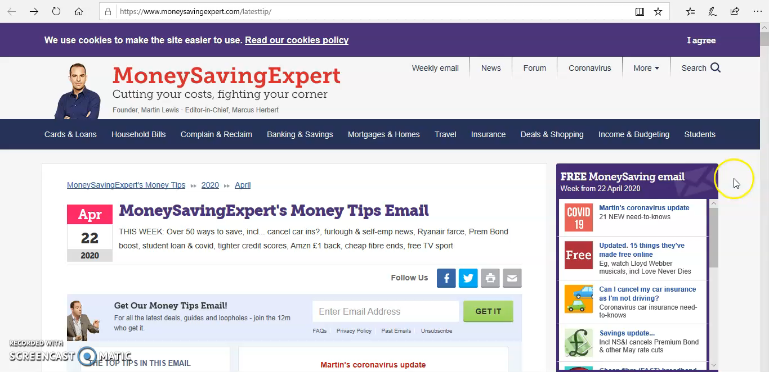
How To Stay Up-to-Date On All Changes
Money Saving Expert – Latest Tips
Notes:
Great for the latest news and how this impacts what you’re entitled to.

Slide 20
Who is Entitled to Sick Pay?
You Are Entitled If You:
Class as an employee & have begun work
Earn £118+ per week on average
Inform employer of COVID-19 self-isolation within 7 days
You May Be Entitled If You:
Are an agency or casual worker
Are on a zero hours contract
Started work recently & haven't received 8 weeks pay
You’re NOT Entitled If You:
Have Had Max SSP (28 Weeks)
Are Self-Employed
Had ESA in the past 12 weeks
Are on Statutory Maternity Pay
Earn less than £118 a week
Are an Agricultural Worker
Notes:
Read slides – emphasise that yellow box should speak to employer to check.
SSP is Statutory Sick Pay
ESA is Employment and Support Allowance

Slide 21
Statutory Sick Pay (SSP) Entitlements
Those Entitled to SSP Receive £99.35 per Week.
Contractual Sick Pay May Result in More than £99.35
Applies from First Day of Symptoms if Covid Related
Doctor’s Note Not Required
  NHS Isolation Note available by visiting NHS 111 online
Notes:
Check your contract or speak to your employer about contractual sick pay.
Weekly amount of SSP changes each year in line with other state benefits – usually in April

Slide 22
Citizens Advice – How to report/ Procedures
Tell Your Employer You’re Sick & Can’t Work
State First Day of Illness, Even a Non-Work Day
Confirm Illness in Writing
  This is “self-certification”
  GOV.UK Employee’s Statement of Sickness (SC2) Form
Get an Isolation Note from NHS Website.
https://www.cbronline.com/news/isolation-note-service-nhsx
Notes:
Following procedures shows employers you are ‘ticking all the boxes’ and being fair
If in Doubt – go check out Citizens advice

Slide 23
Important Notes on Sick Pay
Best Person to Ask about Sick Pay is Your Employer
This Could Be a Difficult Conversation
Consider Preparing with ACAS or Citizen’s Advice
Impartial Services
Advise You on Your Rights
Support in Handling that Conversation Productively
Notes:
Ultimately, the best person for individuals to speak to with regards to their current situation is their employer.
ACAS or Citizen’s Advice have excellent advise when talking to tricky employers
Both are impartial services that can give individuals advice on your employment rights, rules and importantly, how you can professionally go about talking with employers

Slide 24
Working Tax Credits :
Do You Need to Notify if Your Hours Have Changed?
Temporary Hour Reduction
Self Employed: Hours Reduced/Temp Stopped
  No Notification to HMRC for 8 weeks (may be extended)
  WTC Paid at Normal Rate
Permanent Hour Reduction
Redundancy
Childcare
  Inform HMRC As Soon As Change Is Made Permanent
  Credits May Reduce/Stop
Inform HMRC ASAP!
If Not WTC Eligible, Possible 4 Week Run On Payments
Linked to Working Hours
If Working Hours Normal,
Will Receive as Usual
Notes:
WTC based on normal working hours
Do not need to notify HMRC if you have a temporary hour reduction, employed or self employed
YOU DO need to contact HMRC if you have a permanent change to hours, made redundant or cease trading as a self employed person.
Check GOV website for updates and to confirm status.
Childcare is linked to hours – so unless ‘normal’ changes you will still receive.

Slide 25
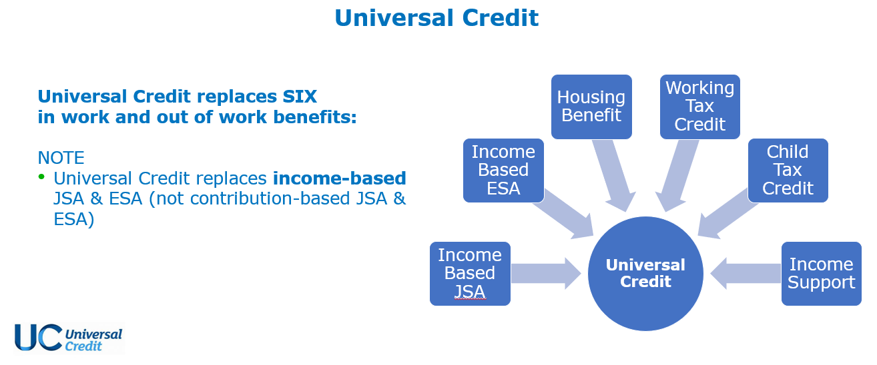

Benefits Overview
Notes:
Universal Credit = new scheme
Legacy = Old scheme
Over 50% of people on UC are in employment
JSA is Job Seekers Allowance
All new claimants go onto Universal Credit
See Diagram for how UC works

Slide 26
Already Accessing Universal Credit
Benefits Continue to be Received as Normal
If affected by Coronavirus, contact your work coach
    use your online journal
    call Universal Credit helpline 0800 328 5644
Some Entitled to SSP or ESA can also claim UC
Notes:
Do not have to attend jobcentre
Contact work coach if you think you have Coronavirus
ESA = Employment and Support Allowance
Check eligibility for universal credit if in doubt – turn2us

Slide 27
Universal Credit: Self Employed
Government Has:
Increased the ‘Standard Allowance’
Removed the ‘Minimum Income Floor’
Both Benefit the Self-Employed
If Single and 25+:
Monthly Standard Allowance
Up to £409.89 (Both New & Existing Claims)
£4,918 Annually
Notes:
See slide for 2021/2022 amounts
Claim factors:
how much you earn/ any partner living with you
whether you’ve got children
amount of savings you've got.
(If you or your partner have combined savings of more than £6,000 you'll get less universal credit, and if you've (and your partner) got savings of £16,000 or over you won't be eligible for universal credit at all.)

Slide 28
UC Assessment Periods & Advance Payments
1 Month Assessment Period Starts on Date of Claim
  5 Week Waiting Period for Money
Assessment Period Income Affects UC Calculation
100% Advance of Estimated First Payment Available
  Must Be Paid Back within 12 Months
Notes:
Income as a final payment from a job can affect assessment – wait if you can

Slide 29
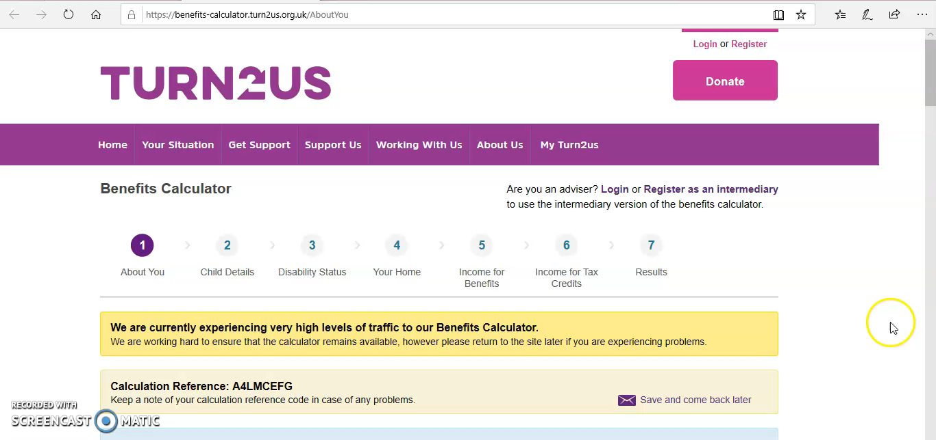
Useful Universal Credit Resources
Turn2Us Benefit Calculator includes all changes and can help you understand if changing your benefits will make you worse off.
Notes:
An easy calculator to identify those benefits you should be receiving

Slide 30
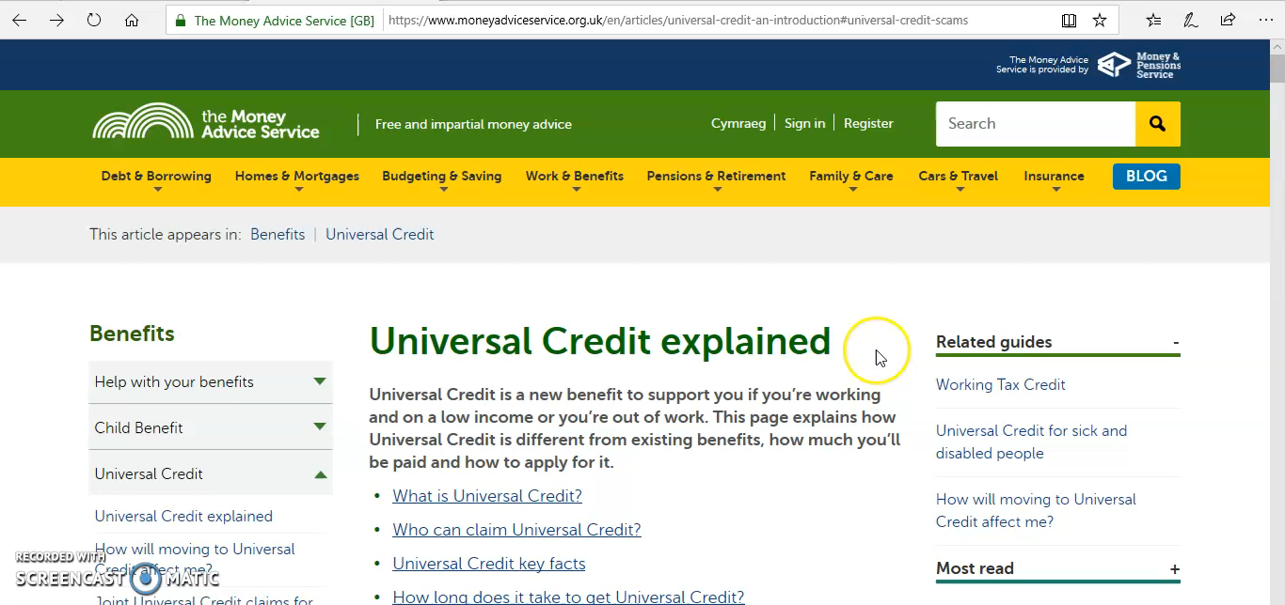
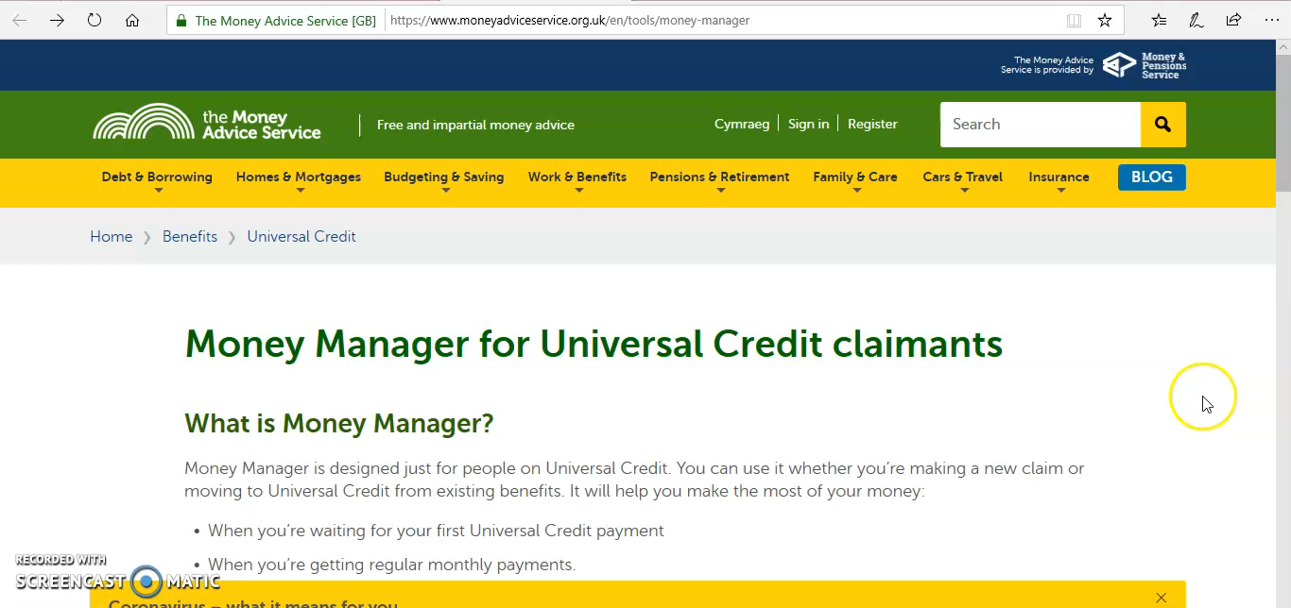
Useful Universal Credit Resources
Money Helper have two useful resources:
1) Simple UC Guide 2) Money Manager
Notes:
Another good guide and calculator

Slide 31
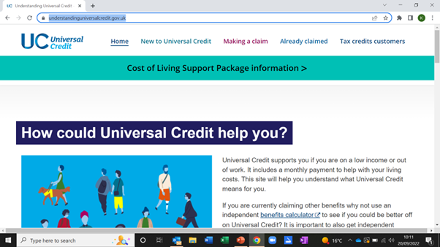
Useful Universal Credit Resources
The GOV website has Information That is Regularly Updated:
Notes:
Check the Gov.uk website to make sure you are up to date with any changes

Slide 32
Income Support Grants: Turn2us Grant Search
Grant search engine to cover essential costs.
Notes:
cover bills, education and training – people who need to retrain, search via postcodes.
Need to write an application, not on someone else’s behalf

Slide 33
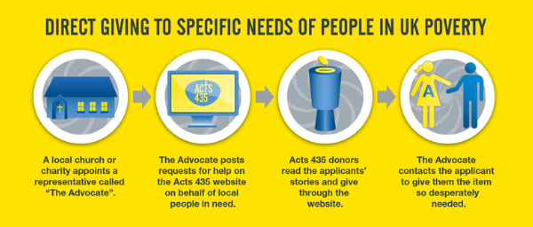
Income Support Grants: ACTS 435
Small, crowdfunded grants on the website.
Very high success rate, available through local churches
Notes:
Small grants – bit like crowdfunding – you can post for an individual help for bills etc and fundraise for them. – good success rate at the moment. It is a Christian organisation
No cost to use it. Do this on behalf of someone else
Applications have to go through a church or charity Advocate. Up to £150 3 times a year per family.

Slide 34

Income Support Grants: National Zakat Foundation
Muslim grant platform to help with basic costs & small debts
Notes:
Muslim grant platform which can help you with basic costs – like food, travel, clothing and monthly bills. It could also help you with small debts – for money owed on credit cards, bank loans, and gas and electricity bills.

Slide 35
Increasing Income: Topping Up Your Earnings
Apply for Government Schemes
Turn2us, Policy in Practice, Entitledto
Answer Online Surveys
YouGov, Prolific, LifePoints,
Swagbucks, StreetBees
Sell Photos Online
Shutterstock and Alamy
Get Paid to Test Websites
Sell Vintage/Unwanted Items
eBay, Amazon, Gumtree,
Facebook , Vinterior, Shpock
Complete Tasks on Fiverr
Join the Gig Economy
Deliveroo, Task Rabbit
Sell Your Crafts on Etsy
Suggestions by PockitUK
Notes:
Summary:
Other ways to top up income
Use approved sources – moneysaving expert has recommendations
Also, some of the websites will give you Amazon vouchers rather than hard cash – this can still help your monthly budget but of course, is important to keep in mind.

Slide 36
Any Questions?

Slide 37
End of Session 1
Notes:
Next session we will be covering budgets.
Why not keep a detailed spending diary of all expenditure until next session. Bring it in and explain any surprises.
Have a look at any existing budgets you might be using and note major items of expenditure

